Slide 1
Extractive Summarization Using Supervised and Semisupervised Learning

Slide 2
Cotraining
We present a learningbased extractive summarization framework that combines sentence features, supervised learning and semisupervised learning. We show that our semisupervised learning approach can achieve comparable performance to supervised learning and reduce the labeling time cost by 50%.

Slide 3
Summarization
We propose a learningbased extractive summarization framework that exploits unlabeled data for sentence selection. We introduce four types of sentence features, i.e., surface, content, event and relevance features, for sentence selection.

Slide 4
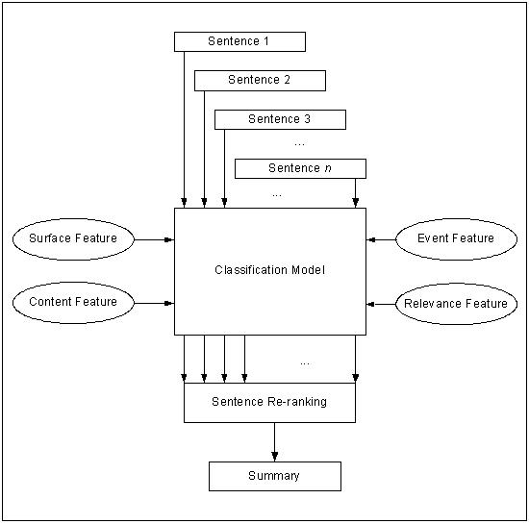

Slide 5
Event Summarization
This paper presents a supervised/semisupervised learning approach for event summarization. The approach incorporates named entity recognition, event extraction, sentence re lationship, and supervised/semisupervised learning.

Slide 6
Supervised Learning for Text Summarization
We propose a supervised learning approach to the problem of automatic summarization. We use a linear support vector machine (SVM) and a naïve Bayesian classifier (NBC) to classify the document into two categories: summary and nonsummary. The classified documents are then used to train a summarization model.

Slide 7
Experiments on Supervised Learning
We propose a new approach to extract important sentences from a document based on supervised learning. The approach is evaluated on a largescale Chinese news dataset.

Slide 8
Supervised and Semisupervised Learning for Extractive Summarization
We investigate surface, content, event, and relevance features and their combinations for extractive summarization with supervised learning approach. Experiments show that the combination of surface, content and relevance features performs best.

Slide 9
Text Summarization
We present a new approach to extractive summarization based on a combination of cotraining and machine learning. Our method uses a large set of unlabeled data and a small set of labeled data to learn a model that predicts the probability of a word being in a summary. We evaluate our method on the TAC 2005 dataset and show that it outperforms the baseline system by a significant margin.

